Slide 1
WRITING PROCESS
AIMUN NOOR

Slide 2
What is the writing process?
A process is a series of actions that are followed to some desired end result. In order for the result to be successful, all steps must be followed.
However, the writing process is more than a set of steps to follow in the right order. Some have broken down the act of writing into steps and tried to suggest a sequence to follow, but the act of writing doesn't follow a straight line.
The writing process looks different for everyone, but there are some basic steps that will help you structure your time when writing any kind of text.

Slide 3
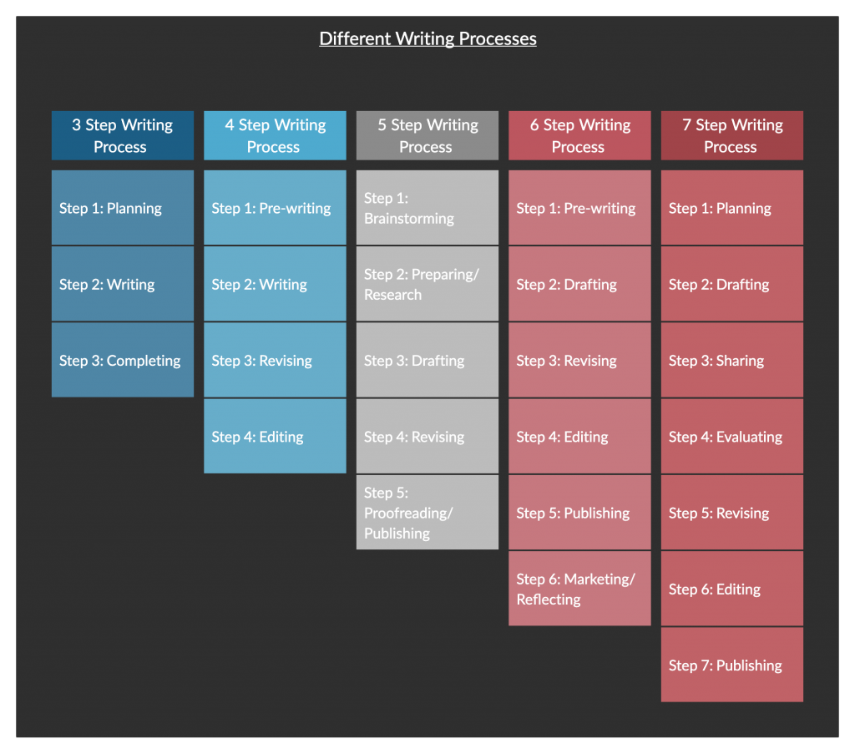
What is the writing process?

Slide 4
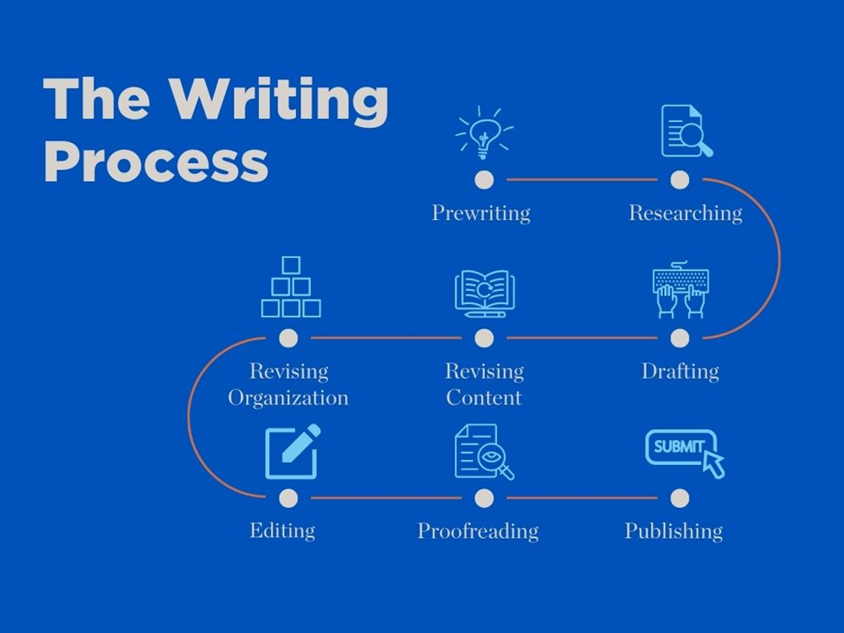
The Writing Process

Slide 5
Step 1: Prewriting
Before you start writing, you need to decide exactly what you’ll write about and do the necessary research.
Coming up with the topic:
The scope of your topics depends on what type of text you’re writing—for example, an essay, a research paper or a dissertation.
Narrow down your idea to a specific argument or question.
Doing the research:
Searching for primary and secondary sources.
Reading the relevant texts closely (e.g. for literary analysis).
Collecting data using relevant research methods (e.g. experiments, interviews or surveys)

Slide 6
Step 2: Planning and outlining
Especially in academic writing, it’s important to use a logical structure to convey information effectively.
It’s far better to plan this out in advance than to try to work out your structure once you’ve already begun writing.
The outline doesn’t have to be final—it’s okay if your structure changes throughout the writing process.
Use bullet points or numbering to make your structure clear at a glance.
Even for a short text that won’t use headings, it’s useful to summarize what you’ll discuss in each paragraph.

Slide 7
Step 3: Drafting
Drafting occurs when you put your ideas into sentences and paragraphs. Here you concentrate upon explaining and supporting your ideas fully. Here you also begin to connect your ideas. Regardless of how much thinking and planning you do, the process of putting your ideas in words changes them; often the very words you select evoke additional ideas or implications.
Write sentences and paragraphs even if they are not perfect.
Create a thesis statement with your main idea. See Thesis Statements
Put the information you researched into your essay accurately without plagiarizing. Remember to include both in-text citations and a bibliographic page. See Incorporating References and Paraphrase and Summary
Read what you have written and judge if it says what you mean. Write some more.
Read it again.
Write some more.
Read it again.
Write until you have said everything you want to say about the topic.

Slide 8
Step 4: Revising
Revision is the key to effective documents. Here you think more deeply about your readers’ needs and expectations. The document becomes reader-centered. How much support will each idea need to convince your readers? Which terms should be defined for these particular readers? Is your organization effective? Do readers need to know X before they can understand Y?
Make it Better
Read what you have written again. See Revising Content and Revising Organization
Rearrange words, sentences, or paragraphs into a clear and logical order.
Take out or add parts.
Do more research if you think you should.
Replace overused or unclear words.
Read your writing aloud to be sure it flows smoothly. Add transitions.

Slide 9
Step 5: Editing and Proofreading
Make it Correct
Be sure all sentences are complete. See Editing and Proofreading
Correct spelling, capitalization, and punctuation.
Change words that are not used correctly or are unclear.
Make sure you are using the appropriate style formatting.
APA Formatting
Chicago Style Formatting
MLA Formatting
Have someone else check your work.

